Slide 1
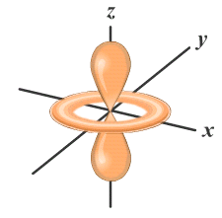
Electron Configuration & Orbitals
Quantum Model
of the Atom
Electrons in Atoms
1s²2s²2p⁶3s²3p⁶4s²3d¹⁰4p⁶5s²4d¹⁰4p⁶5s²4d¹⁰5p⁶6s²4f¹⁴5d¹⁰6p⁶…
Notes:
Objectives:
To describe the quantum mechanical model of the atom.
To describe the relative sizes and shapes of s and p orbitals.

Slide 2
Quantum Model of the Atom
Electrons in Atoms
Courtesy Christy Johannesson www.nisd.net/communicationsarts/pages/chem

Slide 3

I. Waves and Particles
De Broglie’s Hypothesis
  Particles have wave characteristics
  Waves have particle characteristics
Wave-Particle Duality of Nature
Waves properties are significant at small momentum

Slide 4
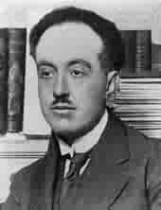
Electrons as Waves
Louis de Broglie (1924)
  Applied wave-particle theory to electrons
  electrons exhibit wave properties
Louis de Broglie
~1924
QUANTIZED WAVELENGTHS
200
150
100
50
0
- 50
-100
-150
-200
Fundamental mode
200
150
100
50
0
- 50
-100
-150
-200
Second Harmonic or First Overtone
200
150
100
50
0
- 50
-100
-150
-200
Standing Wave
0 50 100 150 200
0 50 100 150 200
0 50 100 150 200
Adapted from work by Christy Johannesson www.nisd.net/communicationsarts/pages/chem
Notes:
Louis de Broglie wondered if the converse was true — could particles exhibit the properties of waves?
• de Broglie proposed that a particle such as an electron could be described by a wave whose wavelength is given by
λ = h ,
mν
where h is Planck’s constant, m is the mass of the particle, and ν is the velocity of the particle.
• de Broglie proposal was confirmed by Davisson and Germer, who showed that beams of electrons, regarded as particles, were diffracted by a sodium chloride crystal in the same manner as X
-rays, which were regarded as waves.
• de Broglie also investigated why only certain orbits were allowed in Bohr’s model of the hydrogen atom.
• de Broglie hypothesized that the electron behaves like a standing wave, a wave that does not travel in space.
• Standing waves are used in music: the lowest-energy standing wave is the fundamental vibration, and higher-energy vibrations are overtones and have successively more nodes, points where the amplitude of the wave is zero.
• de Broglie stated that Bohr’s allowed orbits could be understood if the electron behaved like a standing circular wave. The standing wave could exist only if the circumference of the circle was an integral multiple of the wavelength causing constructive interference. Otherwise, the wave would be out of phase with itself on successive orbits and would cancel out, causing destructive interference.

Slide 5
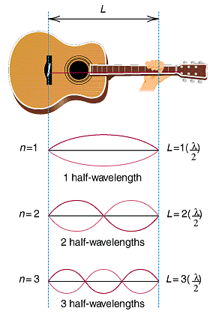
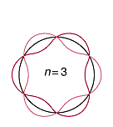
Electrons as Waves
QUANTIZED WAVELENGTHS
n = 4
n = 5
n = 6
Forbidden
n = 3.3
Courtesy Christy Johannesson www.nisd.net/communicationsarts/pages/chem
Notes:
http://www.lakewoodconferences.com/direct/dbimage/50222255/Classical_Guitar.jpg

Slide 6




Electrons as Waves
QUANTIZED WAVELENGTHS
L
n = 4
n = 1
L = 1
(λ)
2
n = 5
1 half-wavelength
n = 2
L = 2
(λ)
n = 6
2
2 half-wavelengths
Forbidden
n = 3.3
n = 3
L = 3
(λ)
2
3 half-wavelengths
Courtesy Christy Johannesson www.nisd.net/communicationsarts/pages/chem
Notes:
http://www.lakewoodconferences.com/direct/dbimage/50222255/Classical_Guitar.jpg

Slide 7
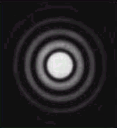
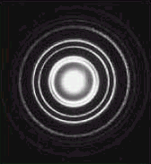
Electrons as Waves
Evidence: DIFFRACTION PATTERNS
VISIBLE LIGHT
ELECTRONS
Davis, Frey, Sarquis, Sarquis, Modern Chemistry 2006, page 105
Courtesy Christy Johannesson www.nisd.net/communicationsarts/pages/chem

Slide 8
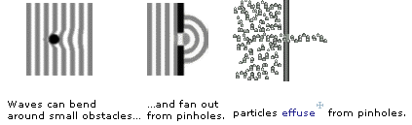
Dual Nature of Light
Waves can bend
around small obstacles…
…and fan out
from pinholes.
Particles effuse from pinholes
Three ways to tell a wave from a particle…
wave behavior particle behavior
waves interfere particle collide
waves diffract particles effuse
waves are delocalized particles are localized

Slide 9

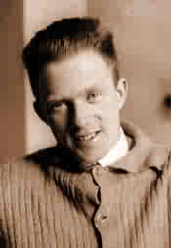
Quantum Mechanics
Heisenberg Uncertainty Principle
  Impossible to know both the velocity and position of an electron at the same time
Werner Heisenberg
~1926
γ
Microscope
Electron
Notes:
Werner Heisenberg (1901 - 1976)
The uncertainty principle: a free electron moves into the focus of a hypothetical microscope and is struck by a photon of light;
the photon transfers momentum to the electron. The reflected photon is seen in the microscope, but the electron has moved
out of focus. The electron is not where it appears to be.
A wave is a disturbance that travels in space and has no fixed position.
The Heisenberg uncertainty principle states that the uncertainty in the position of a particle (Δx) multiplied by the uncertainty in its momentum [Δ(mν)] is greater than or equal to Planck’s constant divided by 4π:
(Δx) [Δ(mν)] ≥ h
4π
• It is impossible to describe precisely both the location and the speed of particles that exhibit wavelike behavior.

Slide 10
Heisenberg uncertainty principle
In order to observe an electron, one would need to hit it with photons having a very short wavelength.
Short wavelength photons would have a high frequency and a great deal of energy.
If one were to hit an electron, it would cause the motion and the speed of the electron to change.
Lower energy photons would have a smaller effect but would not give precise information.

Slide 11
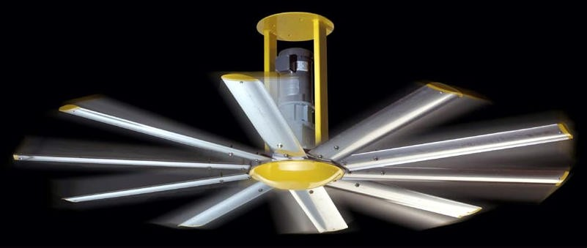
II. The electron as a wave
Schrödinger’s wave equation
  Used to determine the probability of finding the H electron at any given distance from the nucleus
  Electron best described as a cloud
    Effectively covers all points at the same time
    (fan blades)
Notes:
http://news.thomasnet.com/images/large/465/465828.jpg

Slide 12
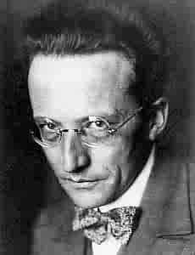
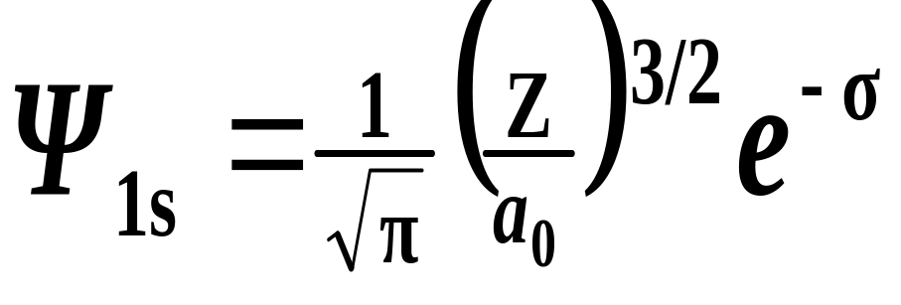
Quantum Mechanics
Schrödinger Wave Equation (1926)
  finite # of solutions ⇒ quantized energy levels
  defines probability of finding an electron
Erwin Schrödinger
~1926
Courtesy Christy Johannesson www.nisd.net/communicationsarts/pages/chem
Notes:
Erwin Schrödinger (1887 – 1926) won the Nobel Prize in Physics in 1933.
In 1926, Erwin Schrödinger developed wave mechanics, a mathematical technique to describe the relationship between the motion of a particle that exhibits wavelike properties (such as an electron) and its allowed energies.
Schrödinger developed the theory of quantum mechanics, which describes the energies and spatial distributions of electrons in atoms and molecules.
Wave function — a mathematical function that relates the location of an electron at a given point in space (identified by x, y, z coordinates) to the amplitude of its wave, which corresponds to its energy, each wave function ψ is associated with a particular energy E.

Slide 13
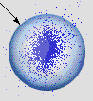
Quantum Mechanics
Orbital (“electron cloud”)
  Region in space where there is 90% probability of finding an electron
90% probability of
finding the electron
Electron Probability vs. Distance
40
30
20
Electron Probability (%)
10
0
0
50
100
150
200
250
Distance from the Nucleus (pm)
Orbital
Courtesy Christy Johannesson www.nisd.net/communicationsarts/pages/chem

Slide 14
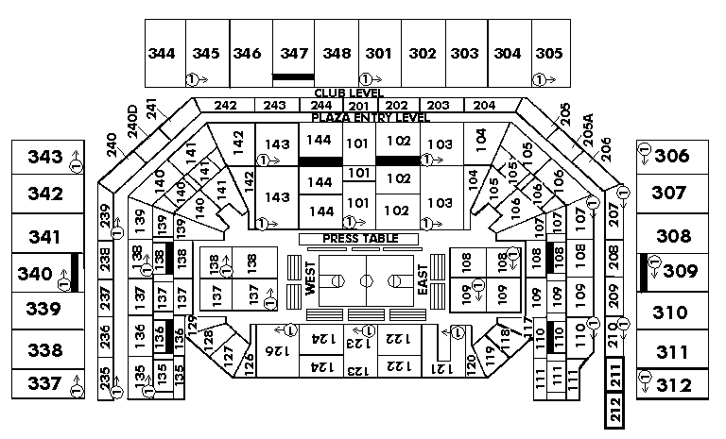
Quantum Numbers
Four Quantum Numbers:
  Specify the “address” of each electron in an atom
UPPER LEVEL
Courtesy Christy Johannesson www.nisd.net/communicationsarts/pages/chem

Slide 15
III. Quantum Numbers
Used the wave equation to represent different energy states of the electrons
Set of four #’s to represent the location of the outermost electron
Here we go…

Slide 16
Quantum Numbers
Principal Quantum Number ( n )
Angular Momentum Quantum # ( l )
Magnetic Quantum Number ( m_{l} )
Spin Quantum Number ( m_{s} )
Notes:
Schrödinger used three quantum numbers
(n, l, and m_{l}) to specify any wave functions.
• Quantum numbers provide information
about the spatial distribution of the electron.

Slide 17
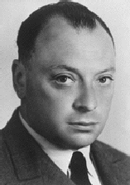
Quantum Numbers
Pauli Exclusion Principle
  No two electrons in an atom can have the same 4 quantum numbers.
  Each electron has a unique “address”:
Wolfgang Pauli
  1. Principal # →
  2. Ang. Mom. # →
  3. Magnetic # →
  4. Spin # →
  energy level
  sublevel (s,p,d,f)
  orbital
  electron
Courtesy Christy Johannesson www.nisd.net/communicationsarts/pages/chem
Notes:
Wolfgang Pauli determined that each orbital can contain no more than two electrons.
Pauli exclusion principle: No two electrons in an atom can have the same value of all four quantum numbers (n, l, m_{l} , m_{s}).
By giving the values of n, l, and m_{l}, we specify a particular orbit.
Because m_{s} has only two values (+½ or -½), two electrons (and only two electrons) can occupy any given orbital, one with spin up and one with spin down.

Slide 18
Relative Sizes 1s and 2s
1s 2s
Zumdahl, Zumdahl, DeCoste, World of Chemistry 2002, page 334

Slide 19
Quantum Numbers
1. Principal Quantum Number ( n )
  Energy level
  Size of the orbital
  n² = # of orbitals in
  the energy level
  Note: #electrons =2n²
1s
2s
3s
Courtesy Christy Johannesson www.nisd.net/communicationsarts/pages/chem
Notes:
s Orbitals
– Orbitals with l = 0 are s orbitals and are spherically symmetrical, with the greatest probability of finding the electron occurring at the nucleus.
– All orbitals with values of n > 1 and l ≥ 0 contain one or more nodes.
– Three things happen to s orbitals as n increases:
1. they become larger, extending farther from the nucleus
2. they contain more nodes
3. for a given atom, the s orbitals become higher in energy as n increases due to the increased distance from the nucleus

Slide 20
The Principal quantum number
      The quantum number n is the principal quantum number.
      – The principal quantum number tells the average
      relative distance of the electron from the nucleus
      – n = 1, 2, 3, 4 . . .
      – As n increases for a given atom, so does the average
      distance of the electrons from the nucleus.
      – Electrons with higher values of n are easier to remove
      from an atom.
      – All wave functions that have the same value of n are
      said to constitute a principal shell because those
      electrons have similar average distances from the
      nucleus.

Slide 21
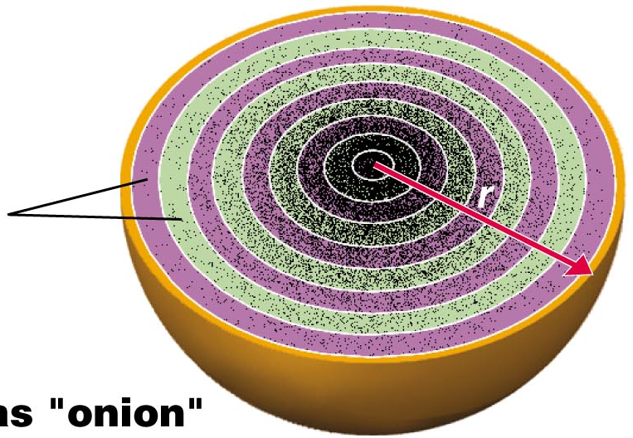
1s orbital imagined as “onion”
Concentric spherical shells
Copyright © 2006 Pearson Benjamin Cummings. All rights reserved.
Notes:
Of course, these are not what atoms “look” like. Rather, they are visual depictions that help us to understand atomic behavior.

Slide 22
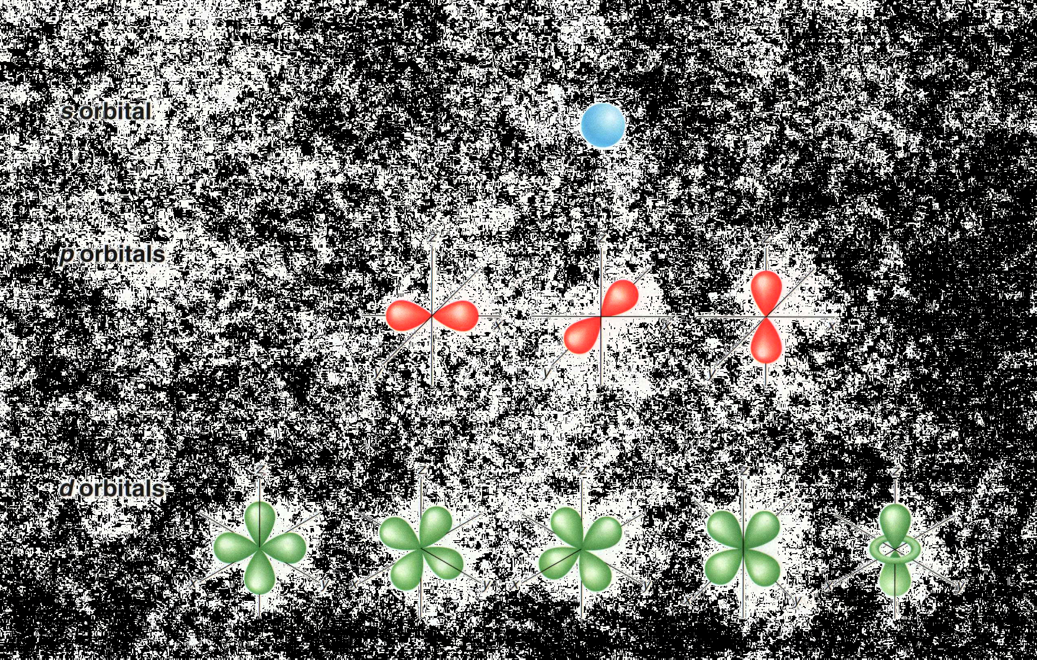
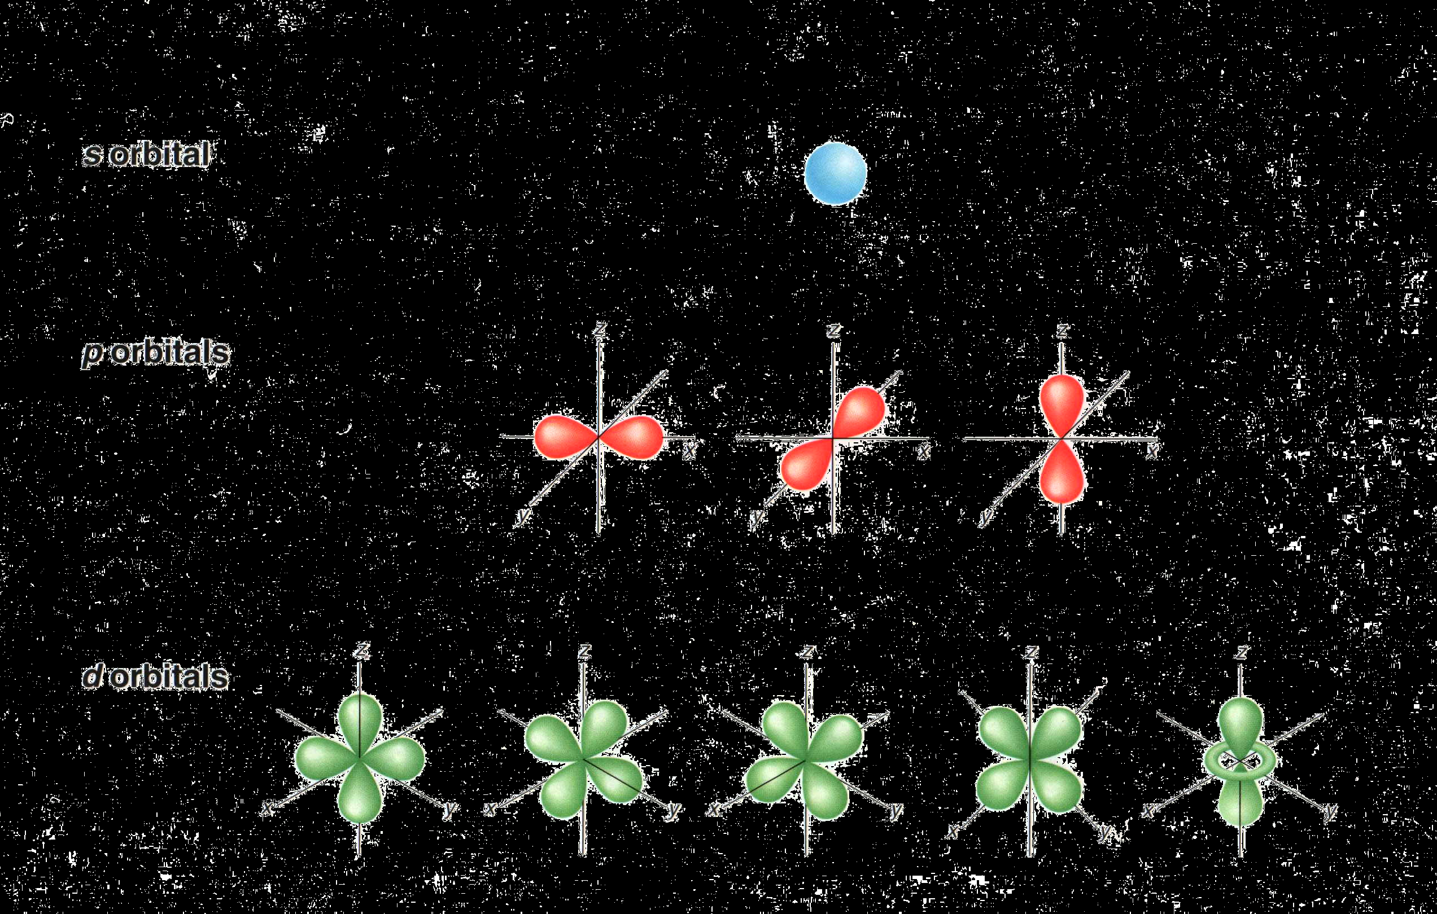
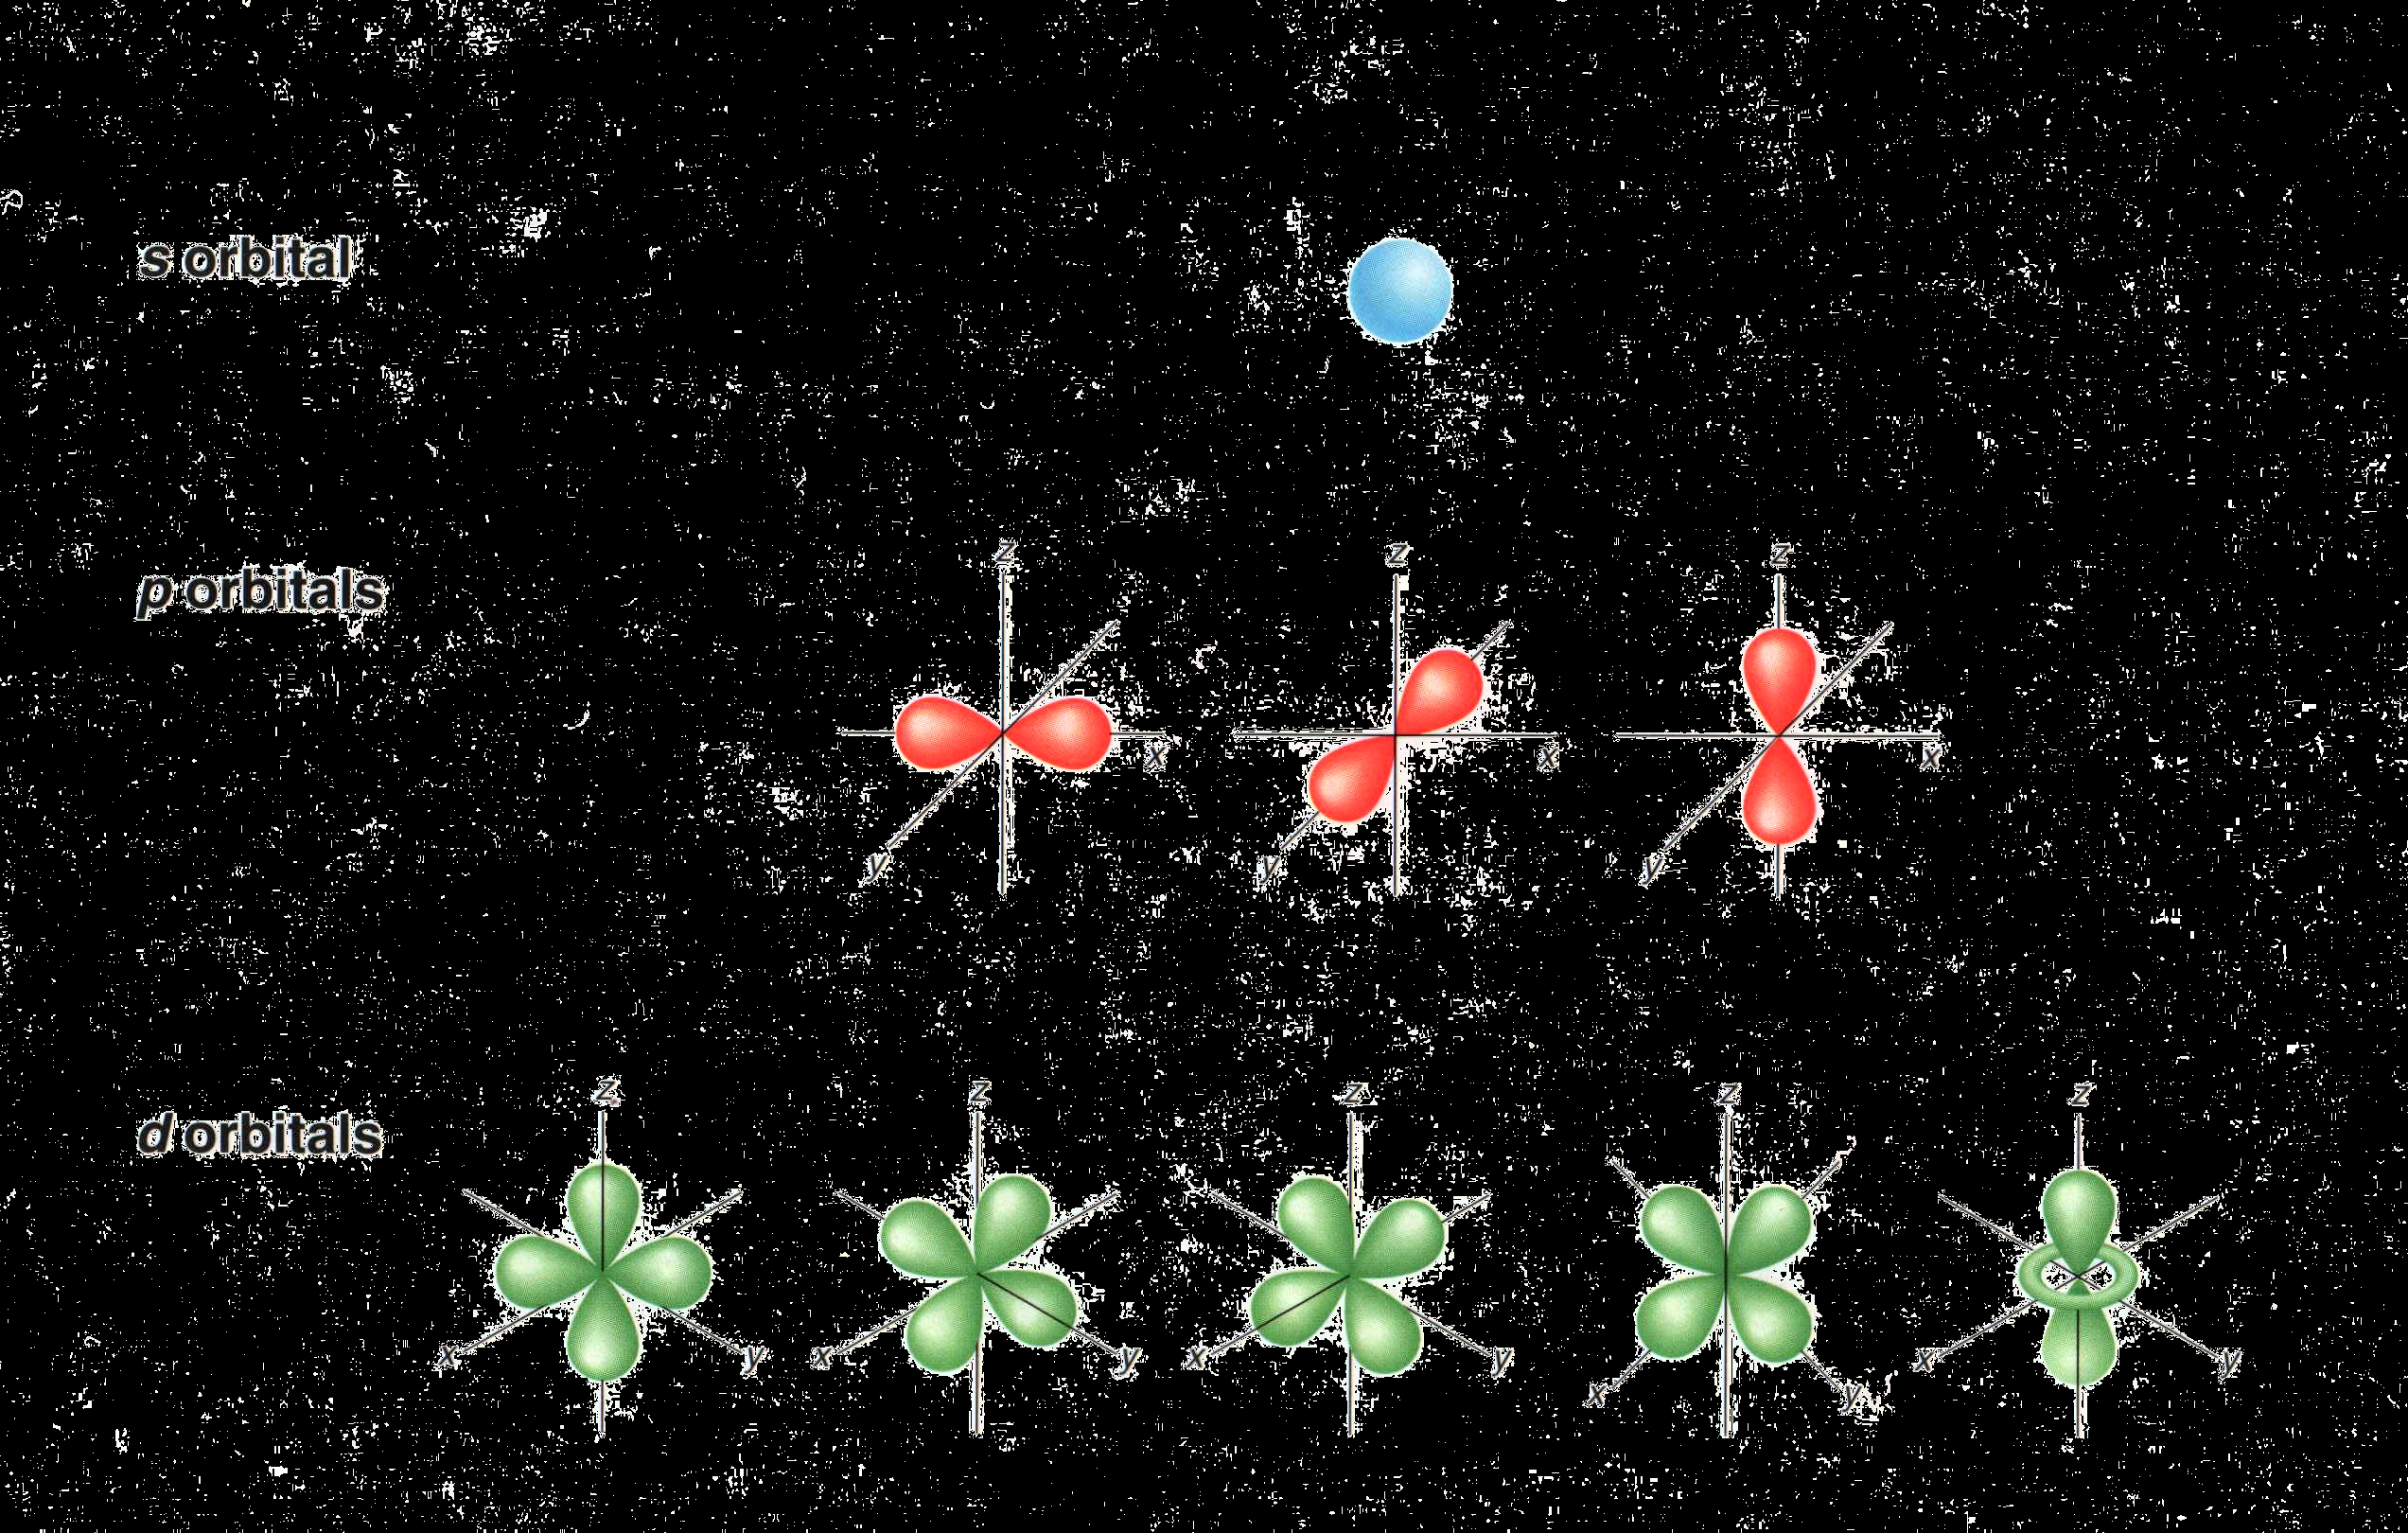
Shapes of s, p, and d-Orbitals
s orbital
p orbitals
d orbitals
Notes:
• p orbitals
– Orbitals with l = 1 are p orbitals and contain a nodal plane that includes the nucleus, giving rise to a “dumbbell shape.”
– The size and complexity of the p orbitals for any atom increase as the principal quantum number n increases.
• d orbitals
– Orbitals with l = 2 are d orbitals and have more complex shapes with at least two nodal surfaces.
• f orbitals
– Orbitals with l = 3 are f orbitals, and each f orbital has three nodal surfaces, so their shapes are complex.

Slide 23
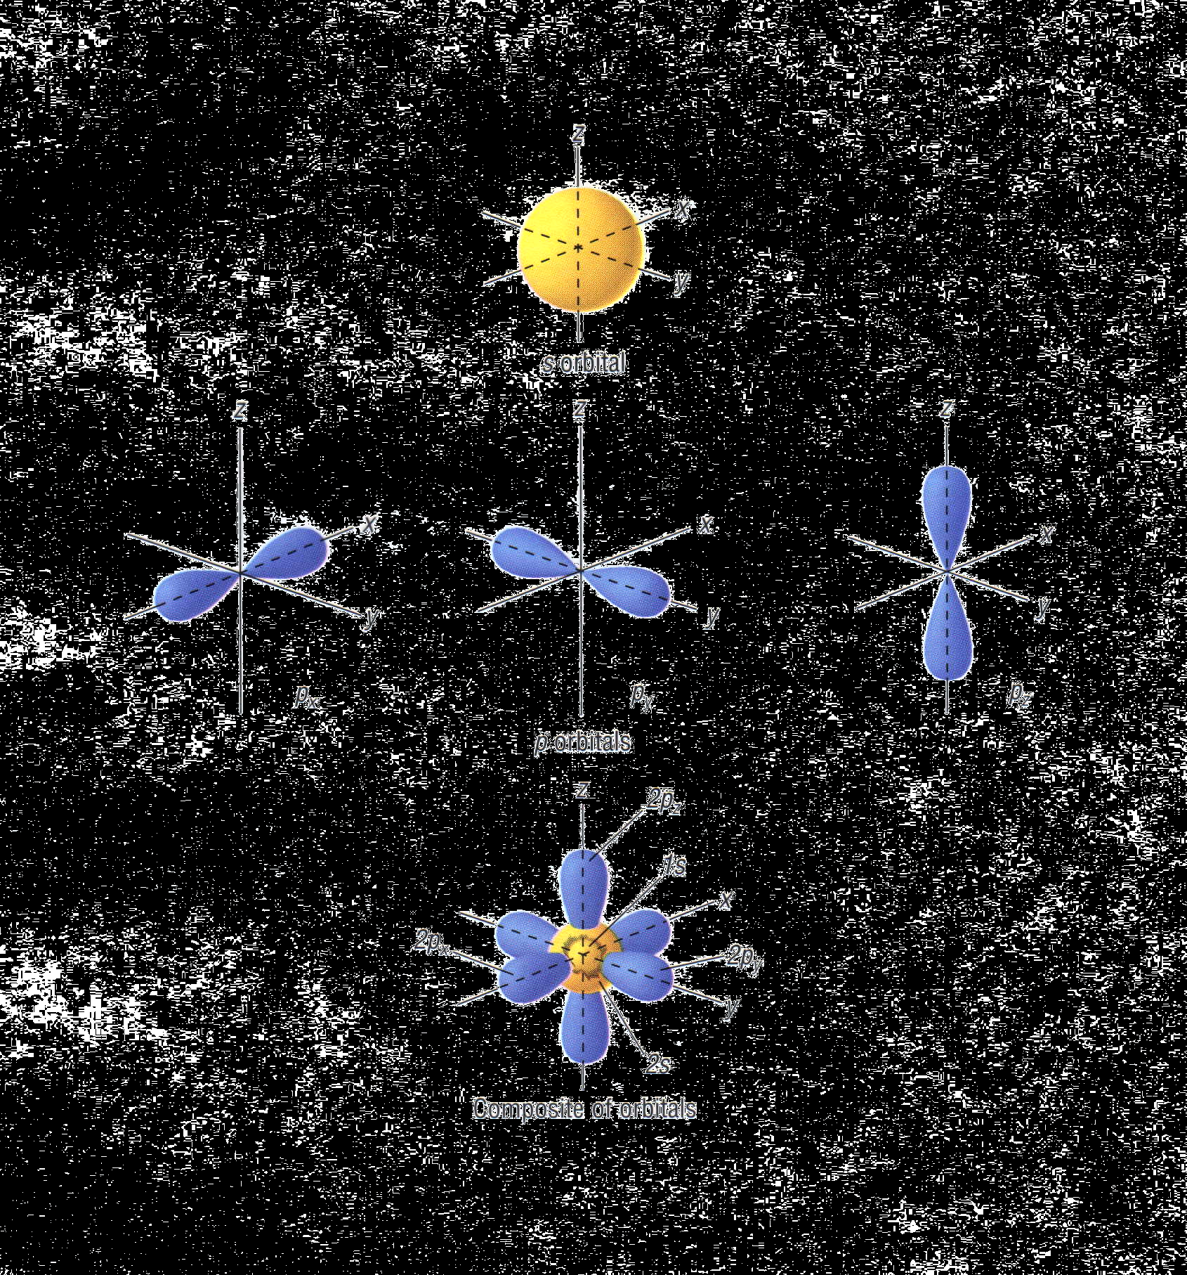
Atomic Orbitals

Slide 24
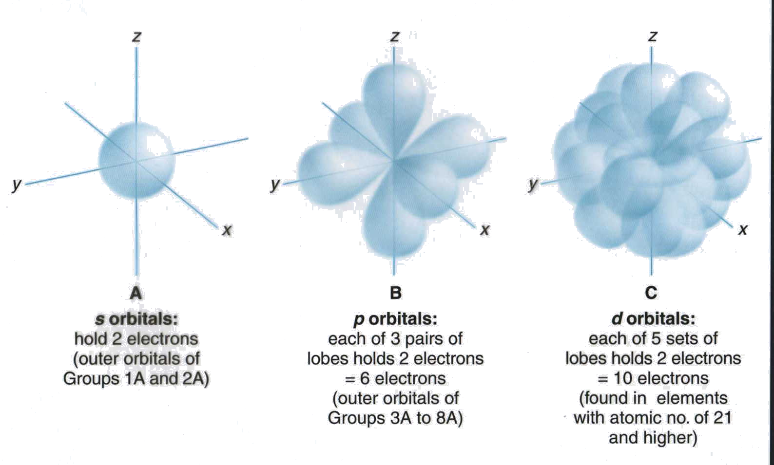
s, p, and d-orbitals
A
s orbitals:
Hold 2 electrons
(outer orbitals of
Groups 1 and 2)
B
p orbitals:
Each of 3 pairs of
lobes holds 2 electrons
= 6 electrons
(outer orbitals of
Groups 13 to 18)
C
d orbitals:
Each of 5 sets of
lobes holds 2 electrons
= 10 electrons
(found in elements
with atomic no. of 21
and higher)
Kelter, Carr, Scott, , Chemistry: A World of Choices 1999, page 82

Slide 25
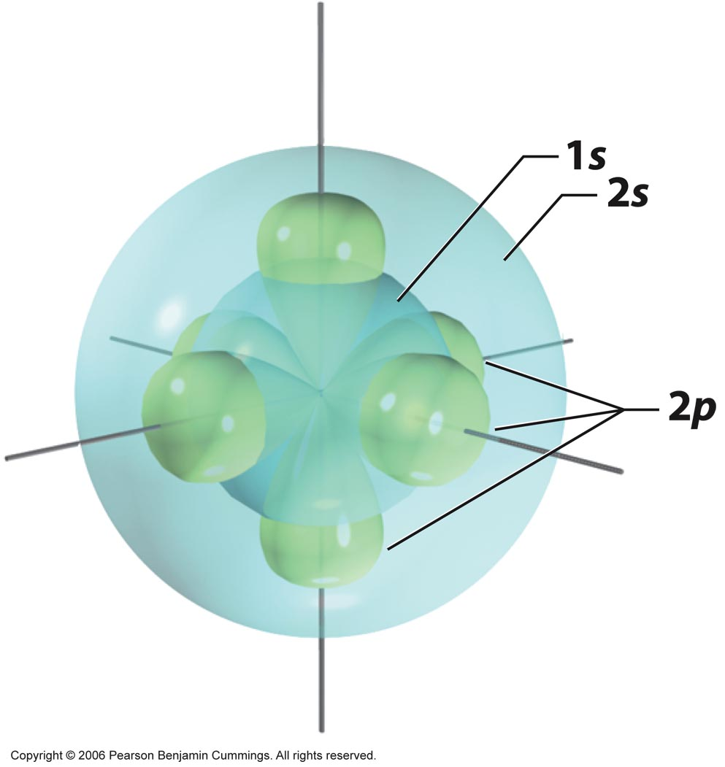
Copyright © 2006 Pearson Benjamin Cummings. All rights reserved.

Slide 26
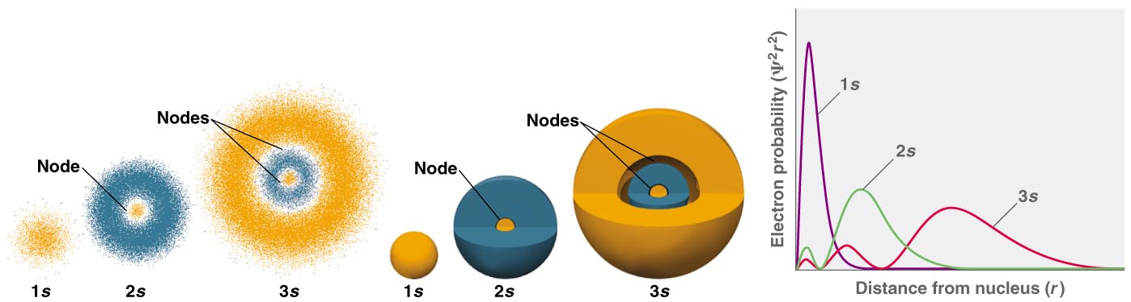
(a) Electron probability (b) Contour probability (c) Radial probability
Copyright © 2006 Pearson Benjamin Cummings. All rights reserved.
Notes:
An Orbital — is the quantum mechanical refinement of Bohr’s orbit
Orbitals are mathematically derived regions of space with different probabilities of containing the electron
The different ways of representing electron probability distributions are
1. Because ψ² gives the probability of finding the electron in a given volume of space, a plot of ψ² versus distance from the nucleus, r, is a plot of the probability density.
Probability density is greatest at r = 0 (at the nucleus) and decreases steadily with increasing distance
2. The radial probability can be calculated by summing the probabilities of the electron being at all points on a series of x spherical shells of radius r₁, r₂ …r_{x −1}, r_{x} and
calculating the probability of finding the electron in each of the spherical shells.

Slide 27
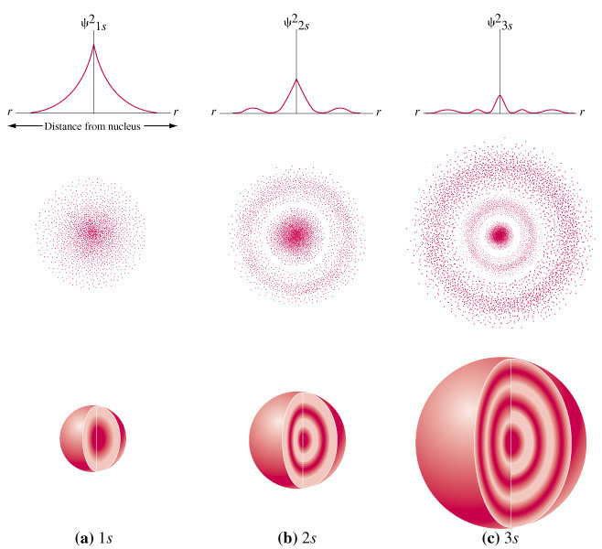
Ψ²1s
Ψ²2s
Ψ²3s
r
r
r
r
r
r
Distance from nucleus
(a) 1s (b) 2s (c) 3s

Slide 28
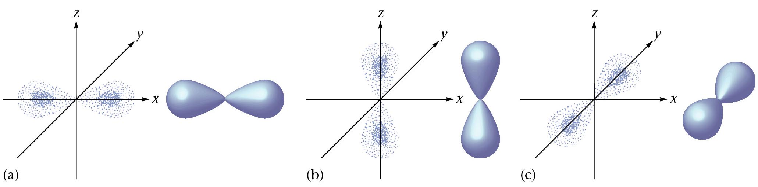
Quantum Numbers
y
y
y
z
z
z
x
x
x
p_{x}
p_{z}
p_{y}

Slide 29
p-Orbitals
p_{x}
p_{z}
p_{y}
Zumdahl, Zumdahl, DeCoste, World of Chemistry 2002, page 335

Slide 30
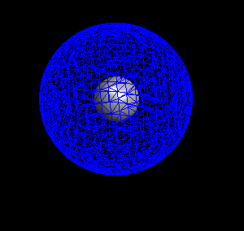
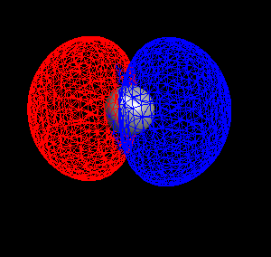
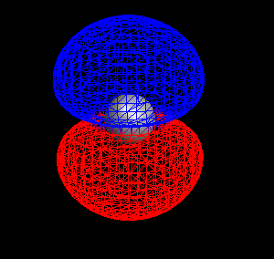
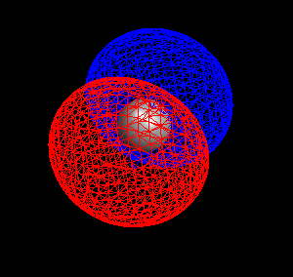
y
y
y
y
z
z
z
z
x
x
x
x
s
p_{x}
p_{z}
p_{y}
2s
2p (x, y, z)
carbon
Mark Wirtz, Edward Ehrat, David L. Cedeno*
Notes:
Using Computational Chemistry to Explore Concepts in General Chemistry
Mark Wirtz, Edward Ehrat, David L. Cedeno*
Department of Chemistry, Illinois State University, Box 4160, Normal, IL 61790-4160

Slide 31
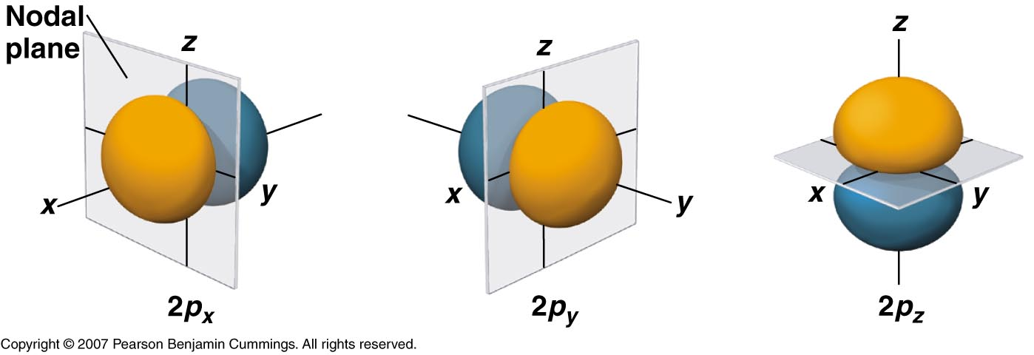
Copyright © 2006 Pearson Benjamin Cummings. All rights reserved.

Slide 32
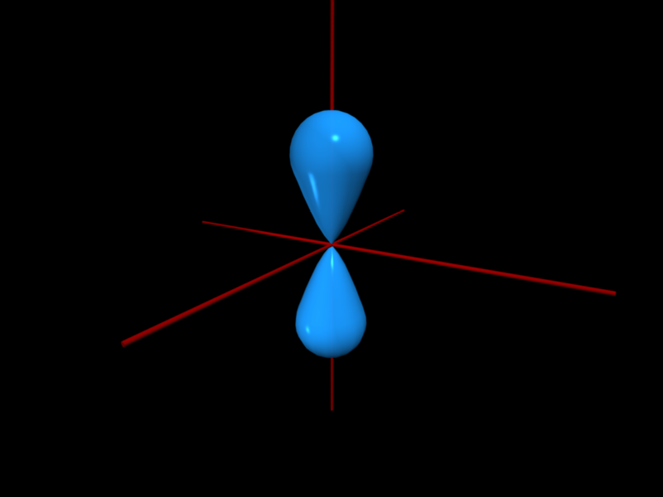
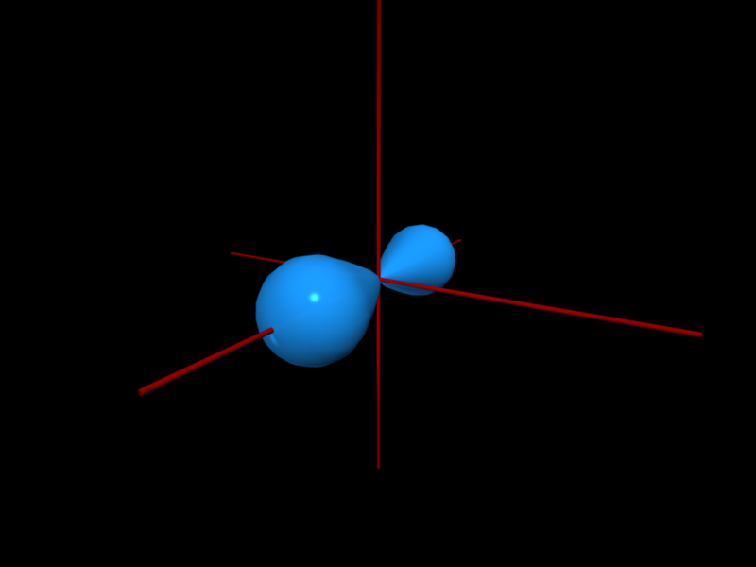
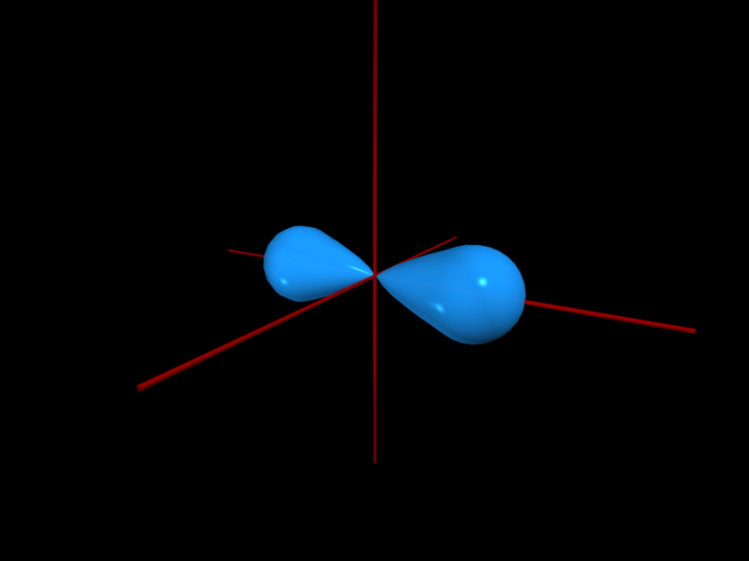
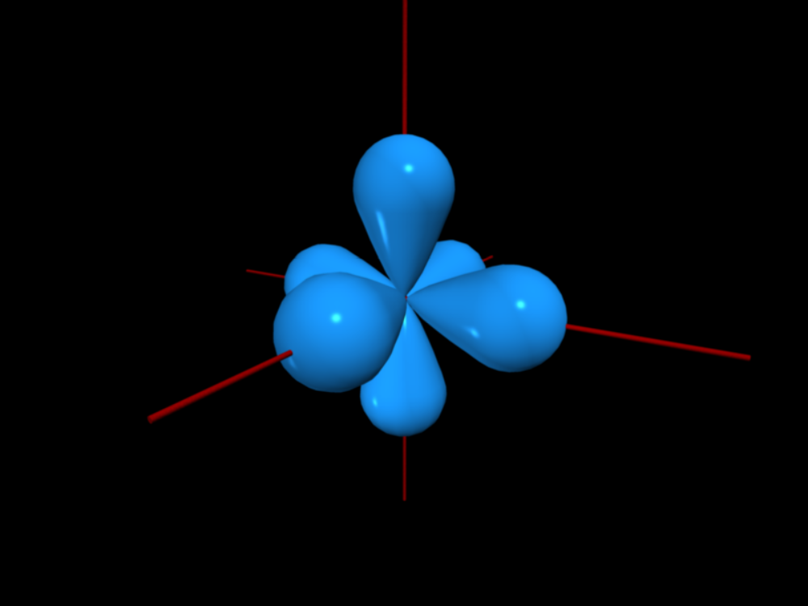
Copyright © 2007 Pearson Benjamin Cummings. All rights reserved.

Slide 36
Copyright © 2007 Pearson Benjamin Cummings. All rights reserved.

Slide 37
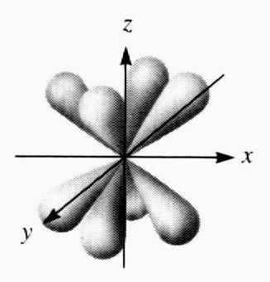



Quantum Numbers
2. Angular Momentum Quantum # ( l )
  Energy sublevel
  Shape of the orbital
s
p
d
f
Courtesy Christy Johannesson www.nisd.net/communicationsarts/pages/chem

Slide 38
The azimuthal quantum number
    Second quantum number l
    is called the azimuthal quantum number
      – Value of l describes the shape of the region of space occupied by the electron
      – Allowed values of l depend on the value of n and can range from 0 to n – 1
      – All wave functions that have the same value of both n and l form a subshell
      – Regions of space occupied by electrons in the same subshell have the same shape but are oriented differently in space
Copyright © 2006 Pearson Benjamin Cummings. All rights reserved.

Slide 39
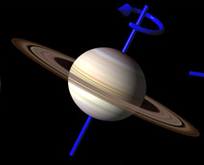
A Cross Section of an Atom
n⁰
p⁺
Rings of Saturn
1s
2s
2p
3s
3p
3d
The first ionization energy level has only one sublevel (1s).
The second energy level has two sublevels (2s and 2p).
The third energy level has three sublevels (3s, 3p, and 3d).
Although the diagram suggests that electrons travel in circular orbits,
this is a simplification and is not actually the case.
Corwin, Introductory Chemistry 2005, page 124
Notes:
First show photograph of Uranus (the planet) rings. From a distance the rings look solid. When viewed more closely, we notice the rings are made of smaller rings.
We can think about the Bohr model of an atom - where the second ring is actually made of two smaller (closely together) rings; the third ring is made of three closely grouped rings, etc...

Slide 40
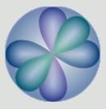
Quantum Numbers
Orbitals combine to form a spherical shape.
2s
2p_{x}
2p_{y}
2p_{z}
Courtesy Christy Johannesson www.nisd.net/communicationsarts/pages/chem

Slide 41
Quantum Numbers
Principal
level
n = 1
n = 2
n = 3
Sublevel
s
s
p
s
p
d
Orbital
p_{x}
p_{y}
p_{z}
p_{x}
p_{y}
p_{z}
d_{xy}
d_{xz}
d_{yz}
d_{z}2
d_{x}2_{- y}2
n = # of sublevels per level
n² = # of orbitals per level
Sublevel sets: 1 s, 3 p, 5 d, 7 f
Courtesy Christy Johannesson www.nisd.net/communicationsarts/pages/chem
Notes:
An abbreviated system with lowercase letters is used to denote the value of l for a particular subshell or orbital:
l = 0 1 2 3
Designation s p d f
• The principal quantum number is named first, followed by the letter s, p, d, or f.
• A 1s orbital has n = 1 and l = 0; a 2p subshell has n = 2 and l = 1(and contains three 2p orbitals, corresponding to m_{l} = –1, 0, and +1); a 3d subshell has n = 3 and l = 2 (and contains five 3d orbitals, corresponding to m_{l} = –2, –1, 0, –1, and +2).

Slide 42
Maximum Capacities of Subshells and Principal Shells
n 1 2 3 4 ...n
l 0 0 1 0 1 2 0 1 2 3
Subshell
designation s s p s p d s p d f
Orbitals in
subshell 1 1 3 1 3 5 1 3 5 7
Subshell
capacity 2 2 6 2 6 10 2 6 10 14
Principal shell
capacity 2 8 18 32 ...2n²
Hill, Petrucci, General Chemistry An Integrated Approach 1999, page 320
Notes:
An abbreviated system with lowercase letters is used to denote the value of l for a particular subshell or orbital:
l = 0 1 2 3
Designation s p d f
• The principal quantum number is named first, followed by the letter s, p, d, or f.
• A 1s orbital has n = 1 and l = 0; a 2p subshell has n = 2 and l = 1(and contains three 2p orbitals, corresponding to m_{l} = –1, 0, and +1); a 3d subshell has n = 3 and l = 2 (and contains five 3d orbitals, corresponding to m_{l} = –2, –1, 0, –1, and +2).
Relationships between the quantum numbers and the number of subshells and orbitals are
1. each principal shell contains n subshells;
– for n = 1, only a single subshell is possible (1s);
for n = 2, there are two subshells (2s and 2p);
for n = 3, there are three subshells (3s, 3p, and 3d);
2. each subshell contains 2l + 1 orbitals;
– this means that all ns subshells contain a single s orbital, all np subshells contain three p orbitals, all nd subshells contain five d orbitals, and all nf subshells contain seven f orbitals.

Slide 43
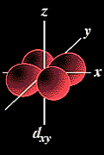
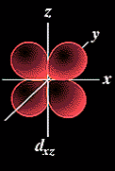
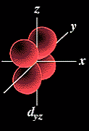
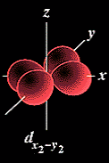
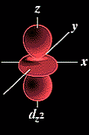
Quantum Numbers
3. Magnetic Quantum Number ( m_{l} )
  Orientation of orbital
  Specifies the exact orbital within each sublevel
Courtesy Christy Johannesson www.nisd.net/communicationsarts/pages/chem

Slide 44
The magnetic quantum number
    Third quantum is m_{l}, the magnetic quantum number
      – Value of m_{l} describes the orientation of the region in space occupied by the electrons with respect to an applied magnetic field
      – Allowed values of m_{l} depend on the value of l
      – m_{l} can range from –l to l in integral steps
      m_{l} = −l, -l + l, . . . 0 . . ., l – 1, l
      – Each wave function with an allowed combination of n, l, and m_{l} values describes an atomic orbital, a particular spatial distribution for an electron
      – For a given set of quantum numbers, each principal shell contains a fixed number of subshells, and each subshell contains a fixed number of orbitals
Copyright © 2006 Pearson Benjamin Cummings. All rights reserved.

Slide 45
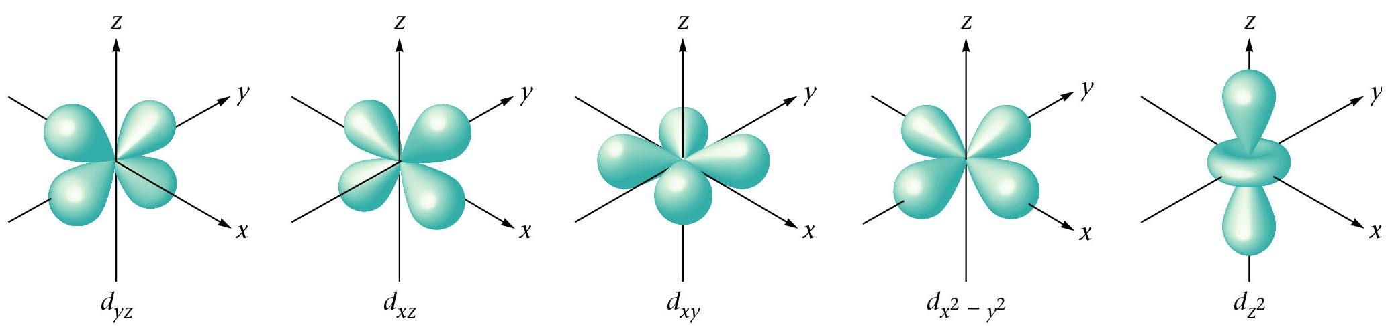
d-orbitals
Zumdahl, Zumdahl, DeCoste, World of Chemistry 2002, page 336

Slide 46
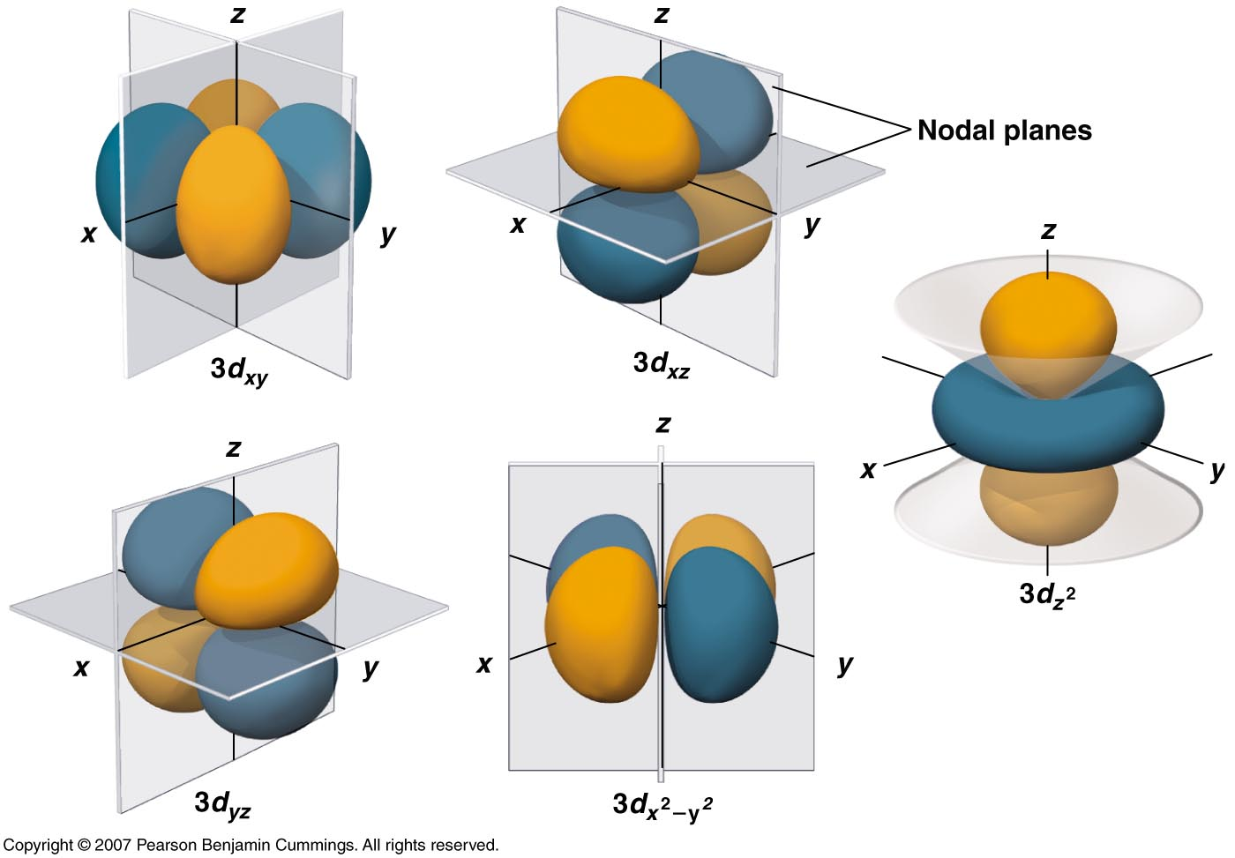
Copyright © 2006 Pearson Benjamin Cummings. All rights reserved.

Slide 47
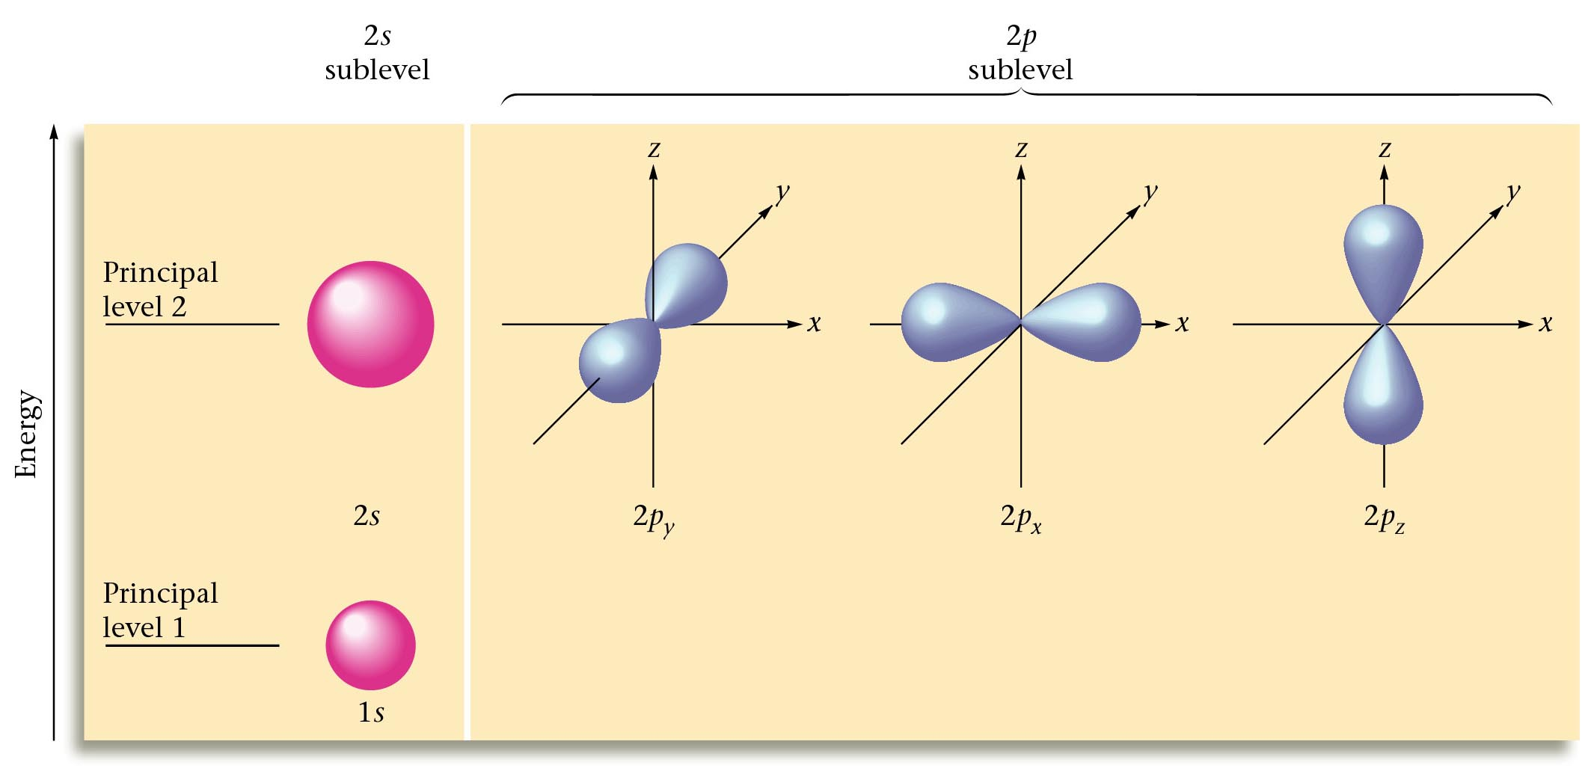
Principal Energy Levels 1 and 2
Notes:
Note that p-orbital(s) have more energy than an s-orbital.

Slide 48

Quantum Numbers
4. Spin Quantum Number ( m_{s} )
  Electron spin ⇒ +½ or -½
  An orbital can hold 2 electrons that spin in opposite directions.
Courtesy Christy Johannesson www.nisd.net/communicationsarts/pages/chem
Notes:
Analyzing the emission and absorption spectra of the elements, it was found that for elements having more than one electron, nearly all the lines in the spectra were pairs of very closely spaced lines.
Each line represents an energy level available to electrons in the atom so there are twice as many energy levels available than predicted by the quantum numbers n, l, and m_{l}.
Applying a magnetic field causes the lines in the pairs to split apart.
Uhlenbeck and Goudsmit proposed that the splittings were caused by an electron spinning about its axis.

Slide 49
Electron Spin: The Fourth Quantum Number
When an electrically charged object spins, it produces a magnetic moment parallel to the axis of rotation and behaves like a magnet.
A magnetic moment is called electron spin.
An electron has two possible orientations in an external magnetic field, which are described by a fourth quantum number m_{s}.
For any electron, m_{s} can have only two possible values, designated + (up) and – (down), indicating that the two orientations are opposite and the subscript s is for spin.
An electron behaves like a magnet that has one of two possible orientations, aligned either with the magnetic field or against it.
Copyright © 2006 Pearson Benjamin Cummings. All rights reserved.

Slide 50
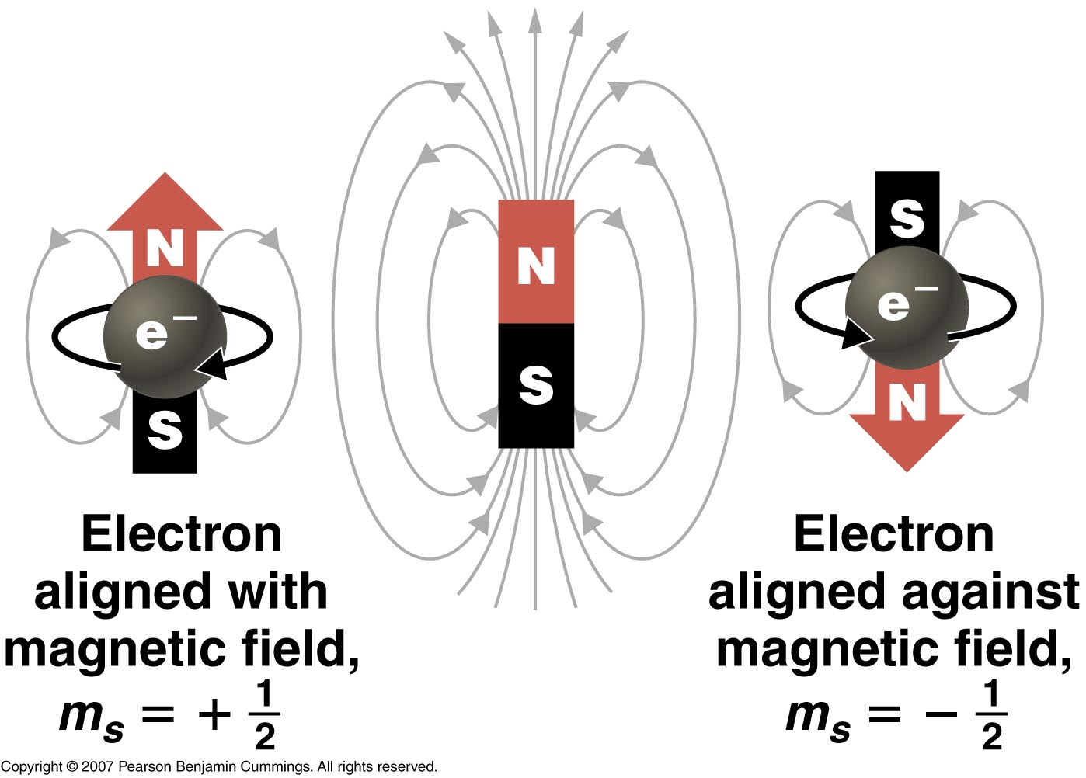
Copyright © 2006 Pearson Benjamin Cummings. All rights reserved.

Slide 51
Allowed Sets of Quantum Numbers for Electrons in Atoms
Level n 1 2 3
Sublevel l
0
0
1
0
1
2
Orbital m_{l}
0
0
1
0
-1
0
1
0
-1
2
1
0
-1
-2
Spin m_{s}
= +1/2
= -1/2

Slide 52
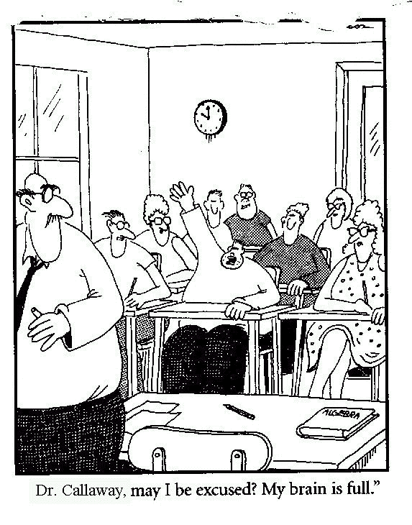
Feeling overwhelmed?
Read Section 5.10 - 5.11!
Chemistry
"Teacher, may I be excused? My brain is full."
Courtesy Christy Johannesson www.nisd.net/communicationsarts/pages/chem

Slide 53
Electron Configuration
Give the electron configuration of the following atoms:
  C
  Ca
  O
  Ne
  Mg

Slide 54
Electron Configuration
Pearson Chapter 3
Lucarelli 7.3-7.4
STAWA Set 9

